Slide 1
Policy Gradients + Actor-Critic
CS 285: Deep Reinforcement Learning
Presenter: Ziniu Hu

Slide 2
Policy Gradient
The policy gradient algorithm
What does the policy gradient do?
Basic variance reduction: causality
Basic variance reduction: baselines
Policy gradient examples
Goals:
Understand policy gradient reinforcement learning
Understand practical considerations for policy gradients
Notes:
policy gradient algorithm is essentially gradient descent or gradient ascent for reinforcement learning it is in some sense the most basic of reinforcement learning algorithms we're going to talk about
we'll talk about some ways to make the policy great and actually work for example by exploiting the fact that the future doesn't cause the past that turns out to be a very important fact in our universe that makes policy gradients work a lot better

Slide 3
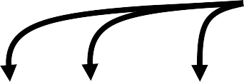
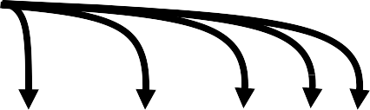
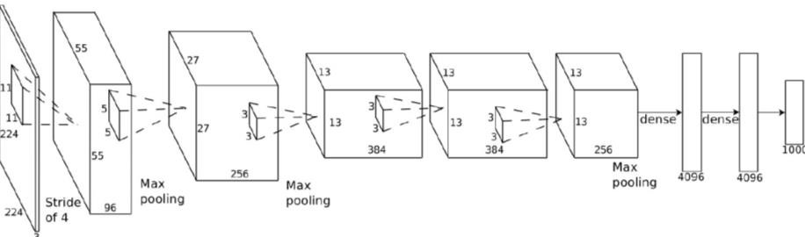

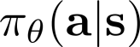
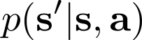
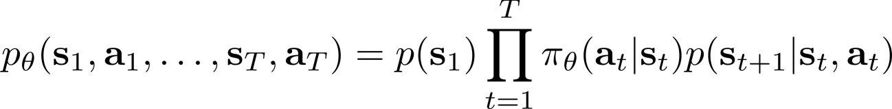
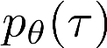
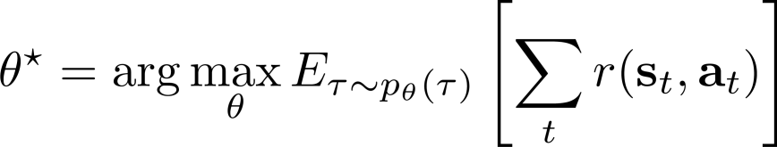
The goal of reinforcement learning
we’ll come back to partially observed later
Notes:
the state and the action together gets sent to the environment in the universe which picks the next state from the unknown transition distribution so this P of s prime given s comma a this is basically kind of a laws of physics that govern this universe outcomes the next state and it goes back into the policy
the objective is the expected value under this trajectory distribution of the total reward along that trajectory so if your reward is let’s say plus 1 if you're driving happily on the road minus 1 if you go off the cliff what you would like to do is you wouldlike to maximize the cumulative reward over the entire trajectory of you
so now let's talk about how we can actually optimize the subject of how we can maximize the expected value of the total reward under the trajectory distribution induced by the policy PI theta

Slide 4
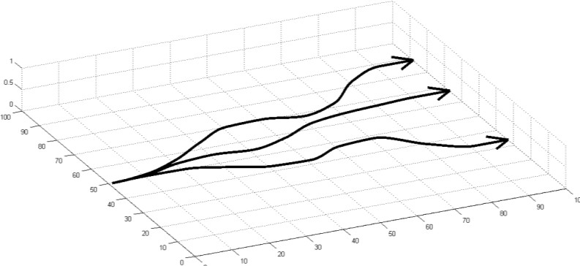

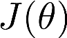
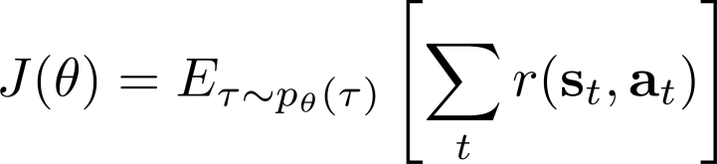
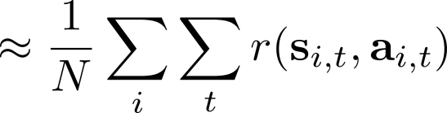
Evaluating the objective
Notes:
one of the ways that you can estimate an expectation is that you can generate samples from the distribution under which the expectation is taken and then averaged together the values of the quantity inside the expectation over those samples so the distribution is p theta of tau the quantity of interest is the sum of the rewards over the trajectories so one of the ways you can estimate that expectation is to obtain samples from p theta of tau and the way that you can obtain those samples is by actually using your policy to act in the world so if your policy controls a car driving on that cliff just drive the car 50 times average the total reward over those 50 trials and that's your estimate of the expected value of the total reward

Slide 5

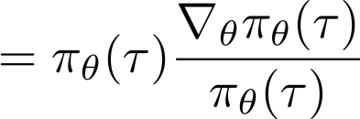
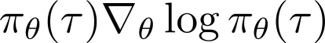
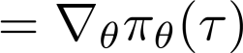
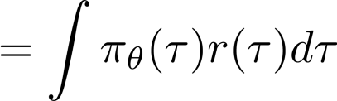
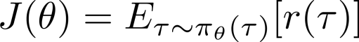
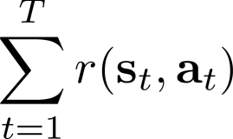
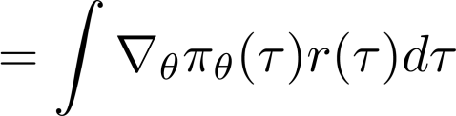
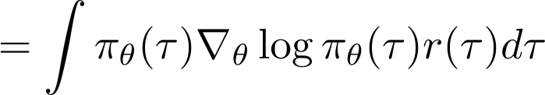
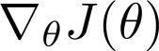
Direct policy differentiation
a convenient identity

Slide 6
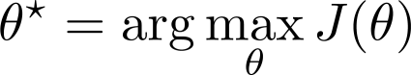
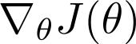
Direct policy differentiation

Slide 7
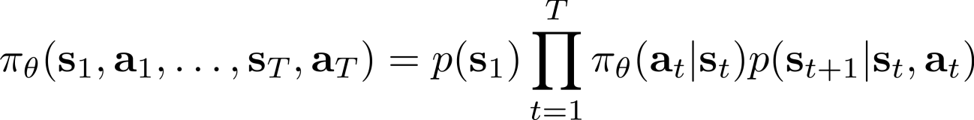

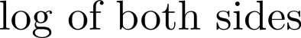
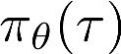
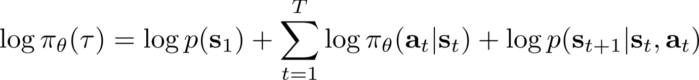
Direct policy differentiation

Slide 8
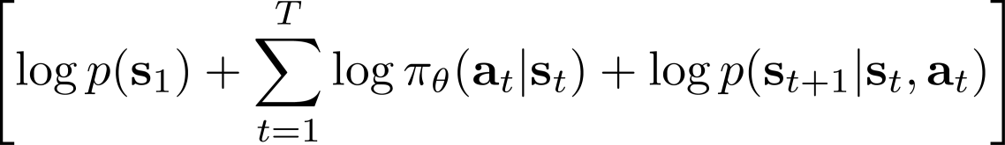
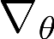
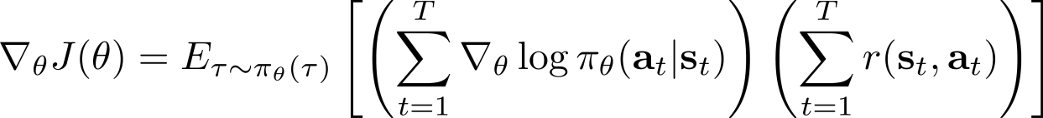
Direct policy differentiation

Slide 9

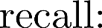

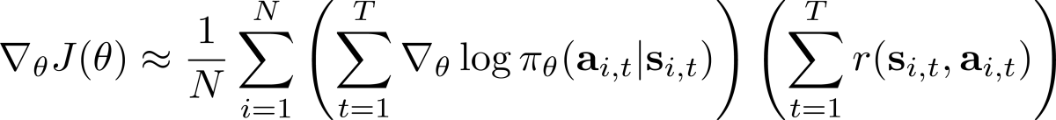
Evaluating the policy gradient
Notes:
the reinforced algorithm works is that you sample a set of trajectories from your policy by literally running that policy in the environment then you estimate the policy gradient using those samples basically using this equation up here and then you take a gradient step in the direction of that gradient which improves your policy so this is the reinforced algorithm if someone says I trained my policy with reinforce this is what they mean only not really because if you actually code this up it won't work

Slide 10
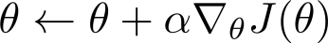

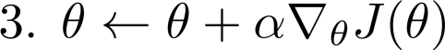
Evaluating the policy gradient
fit a model to estimate return
generate samples
(i.e. run the policy)
improve the policy
Notes:
the reinforced algorithm works is that you sample a set of trajectories from your policy by literally running that policy in the environment then you estimate the policy gradient using those samples basically using this equation up here and then you take a gradient step in the direction of that gradient which improves your policy so this is the reinforced algorithm if someone says I trained my policy with reinforce this is what they mean only not really because if you actually code this up it won't work

Slide 11

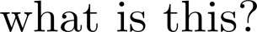
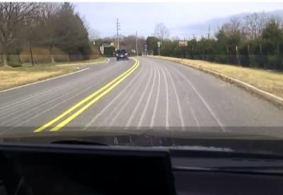


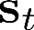
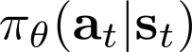
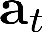
Evaluating the policy gradient

Slide 12
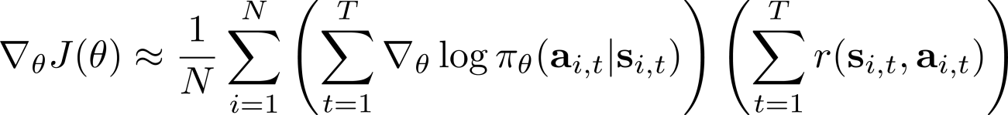
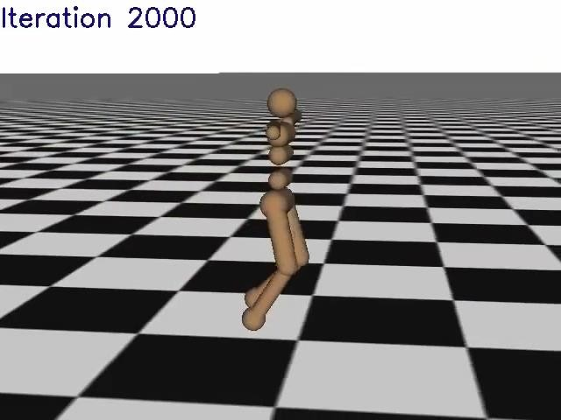
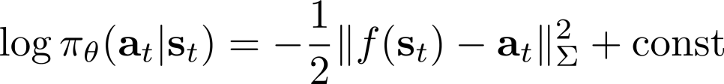
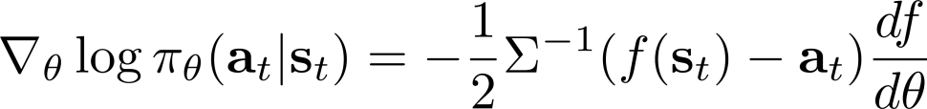
Example: Gaussian policies

Slide 13

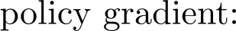
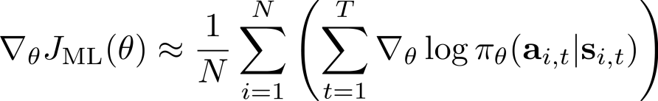

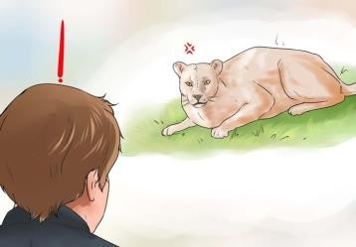








Comparison to maximum likelihood
training
data
supervised learning

Slide 14
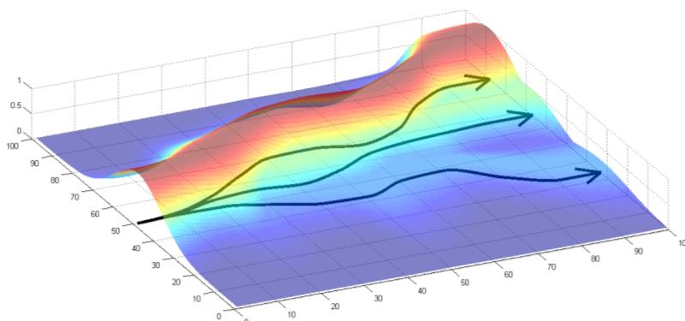
Comparison to maximum likelihood
good stuff is made more likely bad stuff is made less likely
simply formalizes the notion of “trial and error”!
Notes:
so compared to the maximum likelihood gradient we just makes everything more probable right maximum likelihood just takes all of your data and just makes it more likely this one multiplies it by our tau which means that things with bad rewards will actually be made less likely

Slide 15




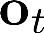
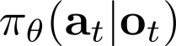
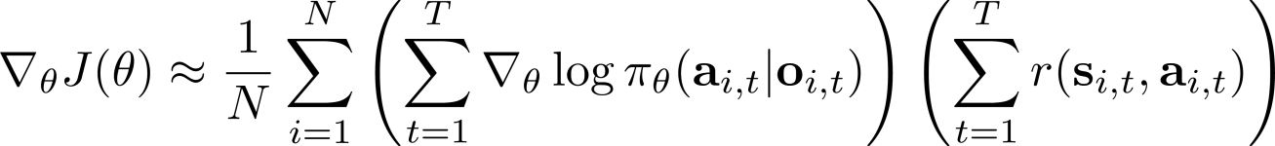
Partial observability

Slide 16


What is wrong with the policy gradient?

Slide 17

What is wrong with the policy gradient?

Slide 18

What is wrong with the policy gradient?

Slide 19

Reducing variance

Slide 20

Reducing variance

Slide 21

Reducing variance

Slide 22

Reducing variance

Slide 23

Baselines

Slide 24


Baselines
but… are we allowed to do that??

Slide 25







Baselines
a convenient identity
but… are we allowed to do that??
subtracting a baseline is unbiased in expectation!
average reward is not the best baseline, but it’s pretty good!

Slide 26

Analyzing variance

Slide 27
Analyzing variance

Slide 28


Analyzing variance
This is just expected reward, but weighted by gradient magnitudes!

Slide 29


Review
The high variance of policy gradient
Exploiting causality
Future doesn’t affect the past
Baselines
Unbiased!
Analyzing variance
Can derive optimal baselines
fit a model to estimate return
generate samples (i.e. run the policy)
improve the
policy

Slide 30


Policy gradient is on-policy
Neural networks change only a little bit with each gradient step
On-policy learning can be extremely inefficient!

Slide 31






Off-policy learning & importance sampling
importance sampling

Slide 32




Off-policy learning & importance sampling
importance sampling

Slide 33





Deriving the policy gradient with IS
a convenient identity

Slide 34



The off-policy policy gradient

Slide 35






A first-order approximation for IS (preview)
We’ll see why this is reasonable
later in the course!

Slide 36




Policy gradient with automatic differentiation

Slide 37
Policy gradient with automatic differentiation
Pseudocode example (with discrete actions):
Maximum likelihood:
# Given:
# actions - (N*T) x Da tensor of actions # states - (N*T) x Ds tensor of states # Build the graph:
logits = policy.predictions(states) # This should return (N*T) x Da tensor of action logits negative_likelihoods = tf.nn.softmax_cross_entropy_with_logits(labels=actions, logits=logits) loss = tf.reduce_mean(negative_likelihoods)
gradients = loss.gradients(loss, variables)

Slide 38

Policy gradient with automatic differentiation
Pseudocode example (with discrete actions):
Policy gradient:
# Given:
# actions - (N*T) x Da tensor of actions # states - (N*T) x Ds tensor of states
# q_values – (N*T) x 1 tensor of estimated state-action values
# Build the graph:
logits = policy.predictions(states) # This should return (N*T) x Da tensor of action logits negative_likelihoods = tf.nn.softmax_cross_entropy_with_logits(labels=actions, logits=logits) weighted_negative_likelihoods = tf.multiply(negative_likelihoods, q_values)
loss = tf.reduce_mean(weighted_negative_likelihoods)
gradients = loss.gradients(loss, variables)
q_values

Slide 39
Policy gradient in practice
Remember that the gradient has high variance
This isn’t the same as supervised learning!
Gradients will be really noisy!
Consider using much larger batches
Tweaking learning rates is very hard
Adaptive step size rules like ADAM can be OK-ish
We’ll learn about policy gradient-specific learning rate adjustment methods later!

Slide 40
Review
Policy gradient is on-policy
Can derive off-policy variant
Use importance sampling
Exponential scaling in T
Can ignore state portion (approximation)
Can implement with automatic differentiation – need to know what to backpropagate
Practical considerations: batch size, learning rates, optimizers
fit a model to estimate return
generate samples (i.e. run the policy)
improve the
policy

Slide 41
Actor-Critic Algorithm
Improving the policy gradient with a critic
The policy evaluation problem
Discount factors
The actor-critic algorithm
Goals:
Understand how policy evaluation fits into policy gradients
Understand how actor-critic algorithms work

Slide 42


Recap: policy gradients
fit a model to
estimate return
generate samples (i.e. run the policy)
improve the policy
“reward to go”

Slide 43








Improving the policy gradient
“reward to go”

Slide 44


Improving the policy gradient
“reward to go”

Slide 45




What about the baseline?

Slide 46

What about the baseline?

Slide 47
What about the baseline?

Slide 48

State & state-action value functions

Slide 49

State & state-action value functions
the better this estimate, the lower the variance
unbiased, but high variance single-sample estimate

Slide 50

State & state-action value functions
fit a model to estimate return
generate samples (i.e. run the policy)
improve the policy
the better this estimate, the lower the variance
unbiased, but high variance single-sample estimate

Slide 51


Value function fitting
fit a model to estimate return
generate samples (i.e. run the policy)
improve the policy

Slide 52
Value function fitting
fit a model to estimate return
generate samples (i.e. run the policy)
improve the policy

Slide 53




Value function fitting
fit a model to estimate return
generate samples (i.e. run the policy)
improve the policy

Slide 54




Policy evaluation examples
TD-Gammon, Gerald Tesauro 1992
AlphaGo, Silver et al. 2016

Slide 55







Policy evaluation
fit a model to estimate return
generate samples (i.e. run the policy)
improve the policy

Slide 56






Monte Carlo evaluation with function approximation
the same function should fit multiple samples!

Slide 57
Can we do better?

Slide 58


Can we do better?

Slide 59





An actor-critic algorithm
fit a model to estimate return
generate samples (i.e. run the policy)
improve the policy

Slide 60

Aside: discount factors
episodic tasks
continuous/cyclical tasks

Slide 61






Aside: discount factors
episodic tasks
continuous/cyclical tasks

Slide 62





Aside: discount factors for policy gradients

Slide 63


Aside: discount factors for policy gradients

Slide 64




Which version is the right one?
Further reading: Philip Thomas, Bias in natural actor-critic algorithms. ICML 2014

Slide 65

Actor-critic algorithms (with discount)

Slide 66


Architecture design
two network design
+ simple & stable
- no shared features between actor & critic
shared network design

Slide 67


Online actor-critic in practice
works best with a batch (e.g., parallel workers)
synchronized parallel actor-critic
asynchronous parallel actor-critic

Slide 68


Critics as state-dependent baselines
+ lower variance (due to critic)
- not unbiased (if the critic is not perfect)
+ no bias
- higher variance (because single-sample estimate)
+ no bias
+ lower variance (baseline is closer to rewards)

Slide 69





Eligibility traces & n-step returns
+ lower variance
higher bias if value is wrong (it always is)
+ no bias
higher variance (because single-sample estimate)
Can we combine these two, to control bias/variance tradeoff?

Slide 70

Generalized advantage estimation
Do we have to choose just one n?
Cut everywhere all at once!
Weighted combination of n-step returns
exponential falloff

Slide 71
Generalized advantage estimation
Do we have to choose just one n?
Cut everywhere all at once!
Weighted combination of n-step returns
exponential falloff
How to weight?
Mostly prefer cutting earlier (less variance)
similar effect as discount!
remember this?
discount = variance reduction!
Schulman, Moritz, Levine, Jordan, Abbeel ‘16

Slide 72

Review
Actor-critic algorithms:
Actor: the policy
Critic: value function
Reduce variance of policy gradient
Policy evaluation
Fitting value function to policy
Discount factors
Carpe diem Mr. Robot
…but also a variance reduction trick
Actor-critic algorithm design
One network (with two heads) or two networks
Batch-mode, or online (+ parallel)
State-dependent baselines
Another way to use the critic
Can combine: n-step returns or GAE
fit a model to estimate return
generate samples (i.e. run the policy)
improve the policy

Slide 73
Actor-critic examples
https://www.youtube.com/watch?v=YXH1BhrDi0k&t=28s

Slide 74


Pytorch Implementation (policy gradient)
https://github.com/pytorch/examples/blob/master/reinforcement_learning/reinforce.py

Slide 75

Pytorch Implementation (policy gradient)
https://github.com/pytorch/examples/blob/master/reinforcement_learning/reinforce.py

Slide 76


Pytorch Implementation (actor-critic)
https://github.com/pytorch/examples/blob/master/reinforcement_learning/actor_critic.py

Slide 77


Pytorch Implementation (actor-critic)
https://github.com/pytorch/examples/blob/master/reinforcement_learning/actor_critic.py

